Slide 1
MJK Solutions
Diagrams
February 14, 2013

Slide 2
Updates
Updated Policies
  Backups
    Documentation - Kenan, Jackie
    Design - Jackie & Mariam, Kenan
    Communication - Kenan, Mariam
  Roles & Rationales
    Kenan - Interested in learning user interface design.
    Jackie - Sharing knowledge, not a single person will perform all the communication. Kenan main person for communication because he is experienced with corporate documentation processes.
    Mariam - Team lead, has the most knowledge about the implementation & scope of this project. Wants to improve her management and leadership skills.
  Plan of Action
    24 hour policy for communication
    Coding
    Testing
    Programming

Slide 3
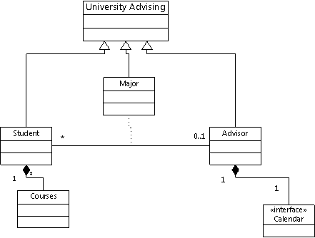
Class UML Diagram

Slide 4
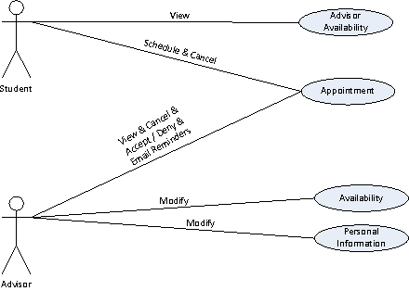
Use Case Diagram

Slide 5
Thank You

